Slide 1

Slide 1
House sales analysis
Oleksandr Galych

Slide 2

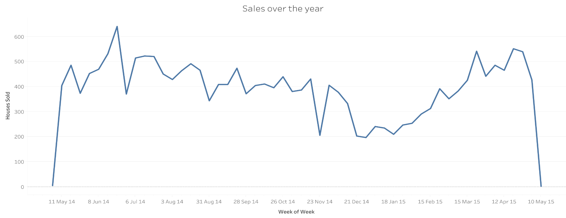
Slide 2
House sales over the year
Decrease
In number of sales
A slow decrease in sales starts from late June and ends in late December. From January to March we can see a huge drop in sales, that on its maximum reaches -50%. The reasons behind that drop should be further investigated.
Increase
In number of sales
Unexpected decrease
From 18 of January market starts to recover and the growth continue until late June
Christmas holydays
2

Slide 3
Slide 2
House sales over week
Sales
Over week
Most sales are happening form
Monday to Friday
97.5% of sales occurred in weekdays
3

Slide 4
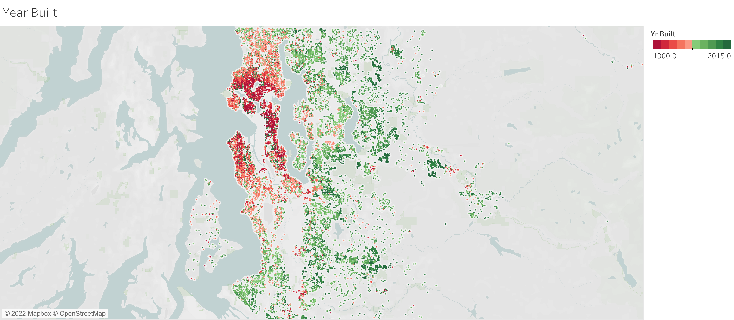

Slide 3
Year of building
General
Tendency:
The older building is, the higher price difference in
e
Average difference to house building year
Average difference
Year built
4

Slide 5
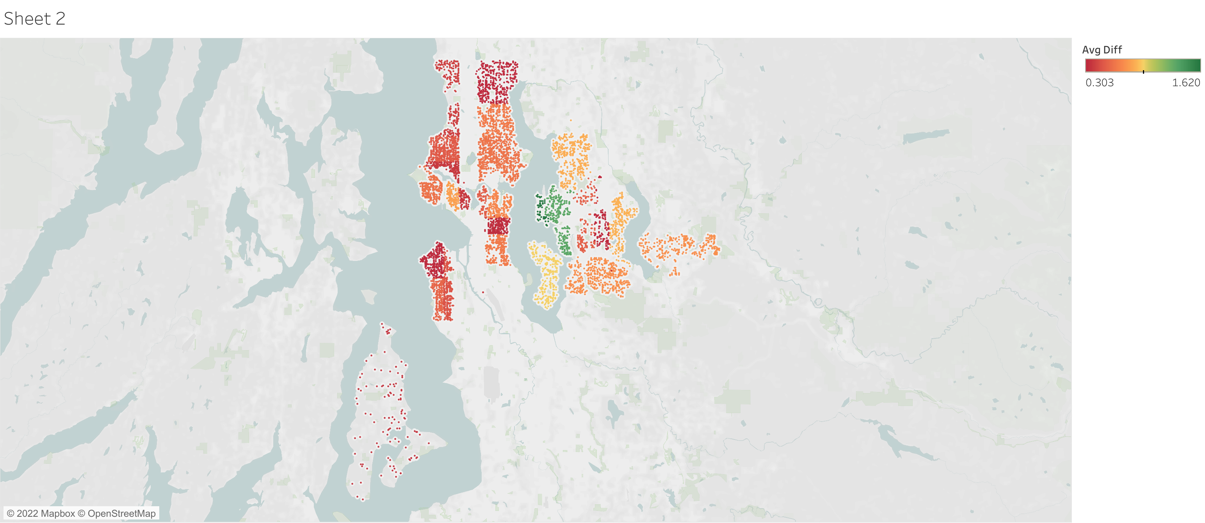
Slide 3
Year of building
General
Tendency:
As we can understand from the graph on the previous slide average difference between renovated and not renovated housing spread a lot. From the spikes on the graph, we can say that there are other factors that are influencing this matric.
On the map given on this slide, we can see an area of our interest – districts where the average difference is higher than 30 %
For the next steps, we will be working only with these locations.
e
4

Slide 6

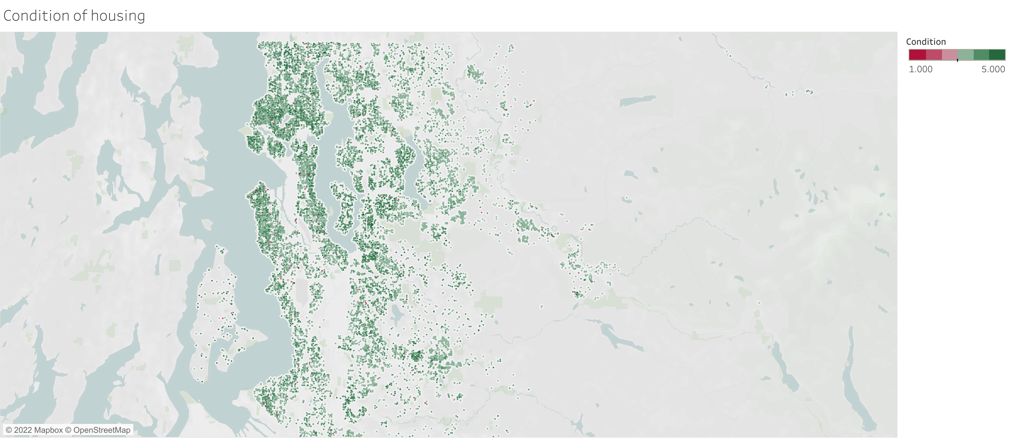
Slide 3
Year of building
3 is the average house condition score over the city city
e
99% of housing has 3+ condition score
42%
Number of houses
Condition score
5

Slide 7


Slide 3
Grade and price correlation
63%
63%
Avg difference
Avg difference
42%
Price difference between 1 and 2 condition points housing 3+ housing .
Average price of house
Why?
-64%
Why it matters?
Min. fence
If we can renovate housing to reach condition 3+ it potentially can increase price on average by 60%
Condition score
6

Slide 8
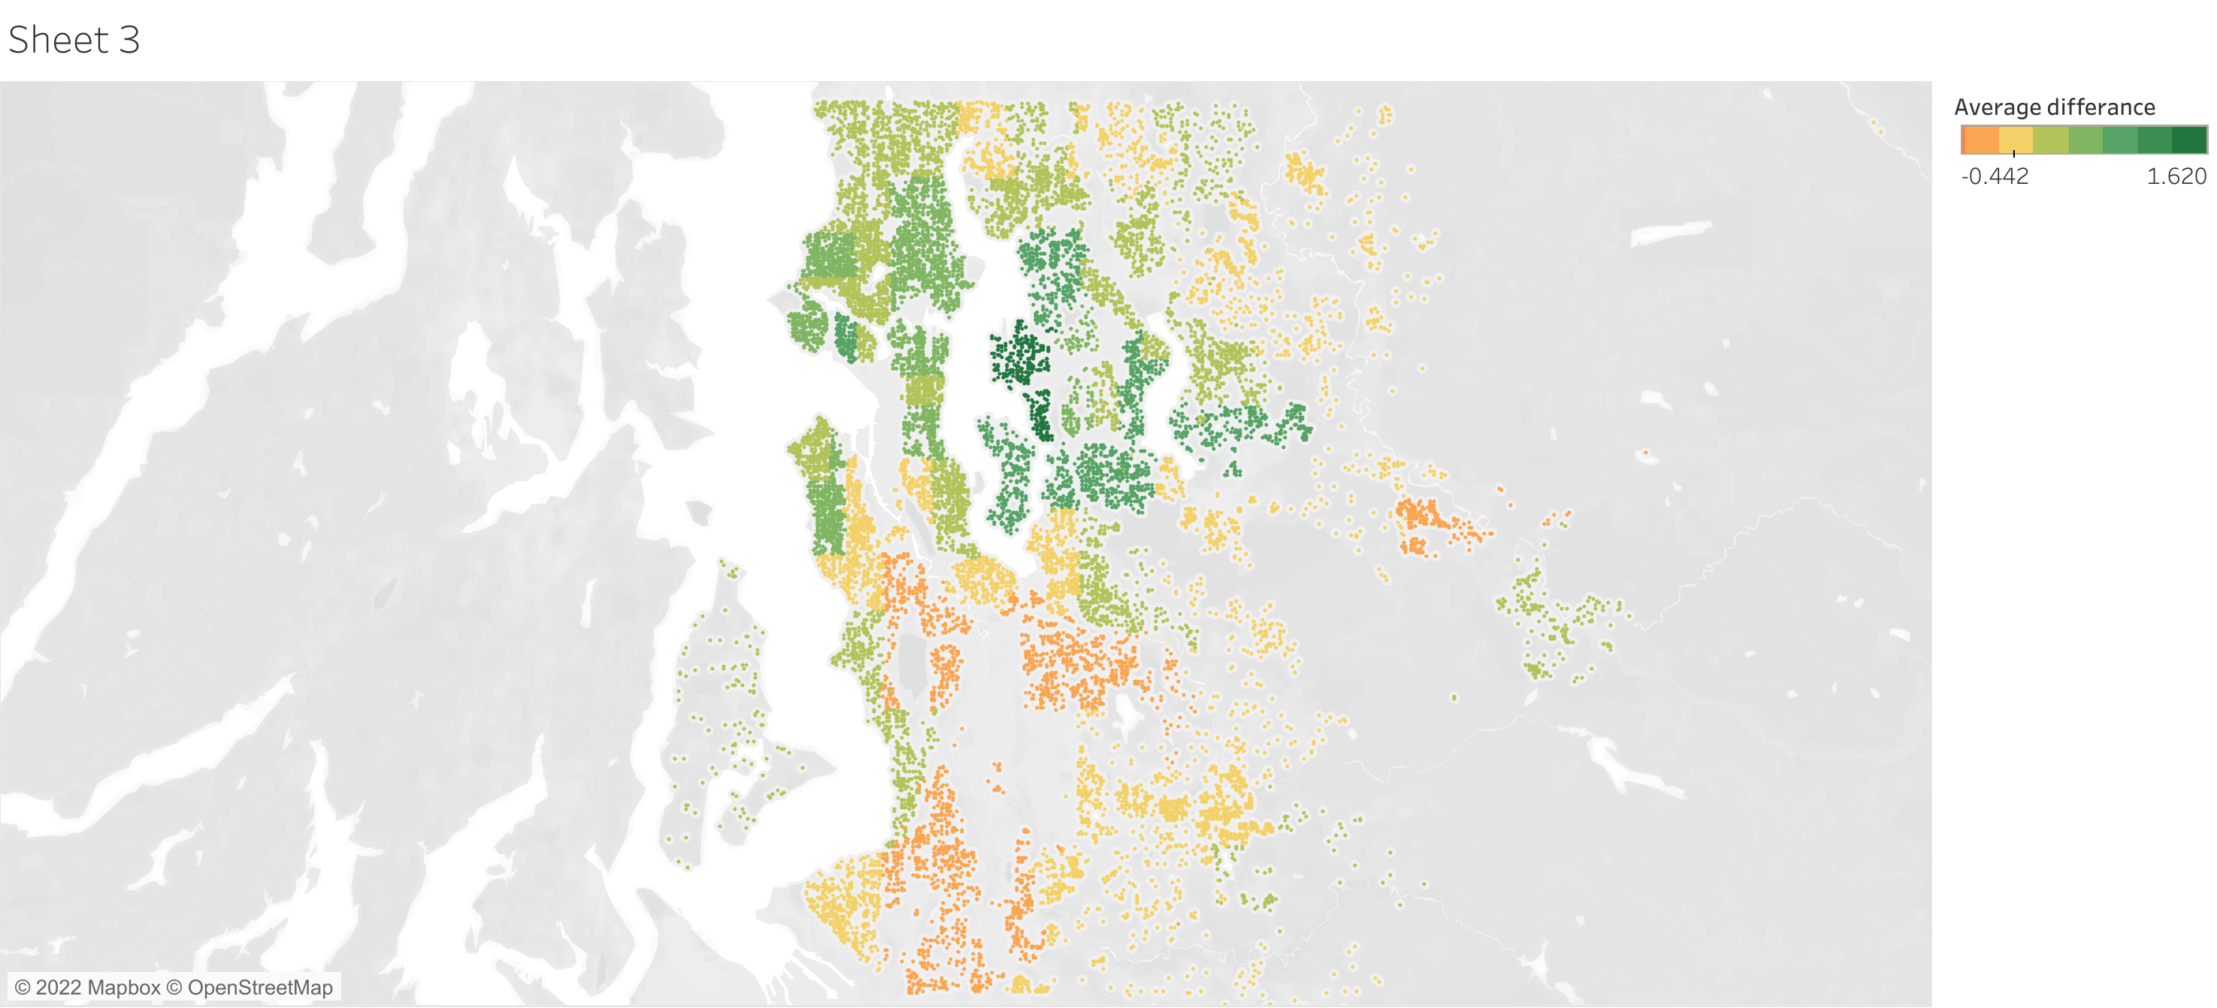

Slide 3
Average price difference between
renovated and NOT renovated housing
e
42%
47.5%
Avg difference
Probability
Average price difference in renovated and NOT renovated housing in Seattle and its agglomeration.
Probability of renovated house being more expansive that not renovated by 30%
358%
-64%
Max. Difference
Min. Difference
Maximum difference in prices. Renovated vs not renovated housing
Minimum difference in prices. . Renovated vs not renovated housing
7

Slide 9
Slide 4
DATA DRIVEN
Bathroom
Bedroom
Floors
Relation of average difference between renovated and NOT renovated housing and number of bathrooms in a house
Relation of average difference between renovated and NOT renovated housing and number of bedrooms in a house
Relation of average difference between renovated and NOT renovated housing and number floors in a house
We are interested in only in 30% difference result
8

Slide 10

Slide 4
DATA DRIVEN
Living area
Lot area
(Sqft)
(Sqft)
Relation of average difference between renovated and NOT renovated housing and number of bedrooms in a house
Relation of average difference between renovated and NOT renovated housing and number of bathrooms in a house
We are interested in only in 30% difference result
9

Slide 11
Slide 5
DATA DRIVEN
Price difference in renovated housing
BEFORE
AFTER
+29%
Before applying recommendations.
Selecting a house on random
After applying suggestions to house selection
42%
71%
10

Slide 12
Slide 5
DATA DRIVEN
Probability of getting 30%+ house difference price after renovation
BEFORE
AFTER
+26%
Before applying recommendations.
Selecting a house on random
After applying suggestions to house selection
50%
76%
11

Slide 13

Slide 10
Conclusion
By selecting houses in the center of Seattle, Mercer Island, Bellevue, Kirkland, Redmond, south Shoreline and applying all suggestions to the house selection we gave above it is possible to significantly increase chances of selecting houses that will increase at the list by 30% after renovation
12

Slide 14

Slide 11
THANK YOU

